Slide 1
BREAD-IGC virtual PhD course on social protection 2025 Rema Hanna, Harvard Kennedy School Ben Olken, MIT

Slide 2
Welcome to the course!

Slide 3
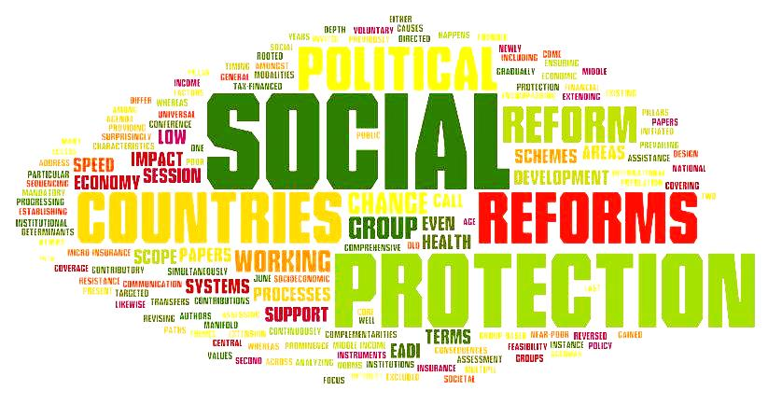
What is social protection?

Slide 4
Different organizations have different definitions
“Social protection refers to policies and actions which enhance the capacity of poor and vulnerable people to escape from poverty and enable them to better manage risks and shocks.” – OECD
“Social protection and labor systems, policies, and programs help individuals and societies manage risk and volatility and protect them from poverty and destitution—through instruments that improve resilience, equity, and opportunity” – World Bank
“Social protection can be understood as a set of public actions which address not only income poverty and economic shocks, but also social vulnerability, thus taking into account the interrelationship between exclusion and poverty.” – UNICEF

Slide 5
In this course…
Broadly speaking, we’ll see key goals of social protection programs
Supporting basic levels of standard of living
Helping people manage the financial costs of risks through social insurance

Slide 6
Standard of living support vs. social Insurance
Income distribution

Slide 7
Standard of living support
Income distribution

Slide 8
Social Insurance
Income distribution

Slide 9
In this course…
Broadly speaking, we’ll see key goals of social protection programs
Supporting basic levels of standard of living
Helping people manage the financial costs of risks through social insurance
But as we will see, we’ll explore a wide variety of programs that encompass these plus additional goals. For example:
Conditional cash transfers also seek to break the intra-generational cycle of poverty as well as supporting current income
Graduation programs seek to provide capital and training to help current generations escape poverty in the future
Workfare programs may provide a mix of income support to the temporarily unemployed and and social insurance against risk of job loss

Slide 10
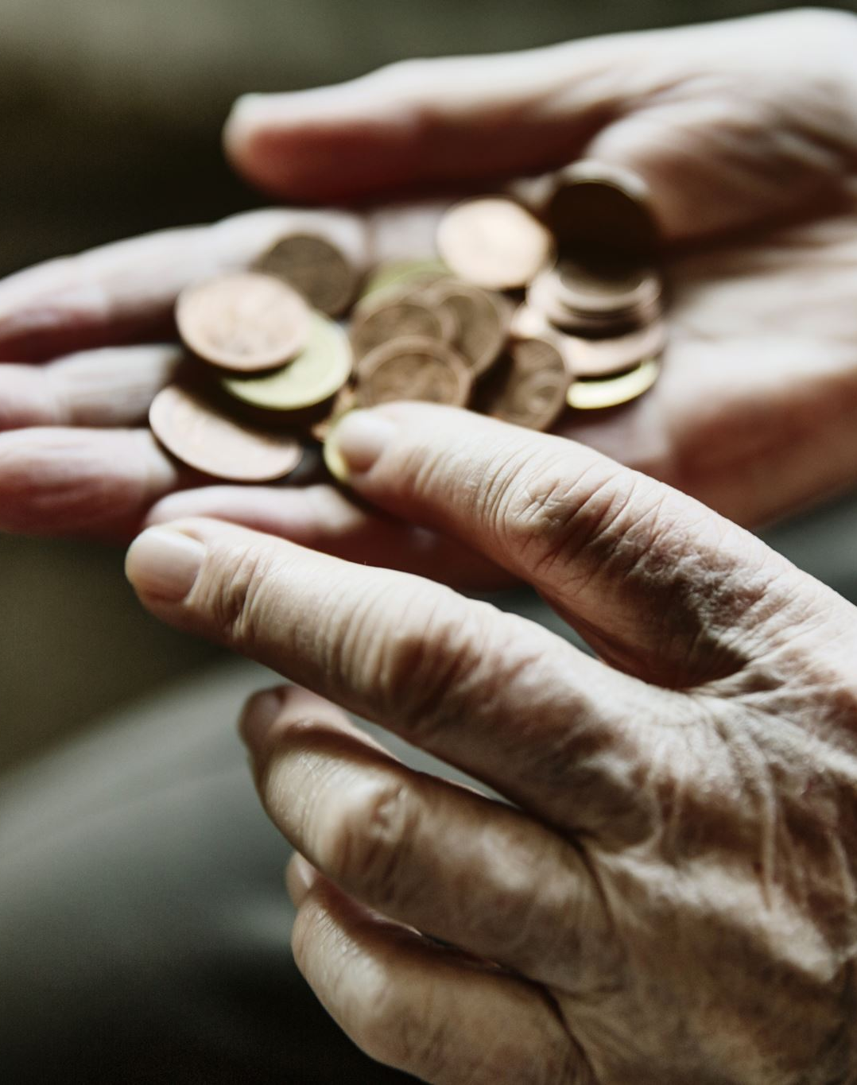
Social Protection is important
Cash transfers and food support programs help people meet their basic needs
Conditional cash transfers can invest in the health and education of children, supporting the current generation while also reducing the transmission of intergenerational poverty
Pensions can help the elderly from falling into poverty
Health insurance can help people get necessary health care, while also helping to ensure that a health emergency does not drive someone into debt or poverty

Slide 11
How pervasive is it?
Over 2.5 billion people covered by at least one type of social protection program
Some type of cash transfer for the poor in more than 120 countries
Some type of social pension program in more than 70 countries
Notes:
Although many people who would need assistance are not cover by it, as we note below

Slide 12
Research Explosion in Recent Years
Banerjee et al (2024) JEL reviewed over 300 papers
Crosta et al (2025) meta-review of cash transfers alone included 115 papers
Over 1000+ citations in the Handbook of Social Protection, forthcoming in 2026

Slide 13
Politically contentious, driven in part by a series of myths

Slide 14
Myth #1: Programs Create Negative Incentives
People who get these programs are lazy, prefer to be on the “dole”
They spend their money on the ills of society–cigarettes, alcohol, and drugs.

Slide 15
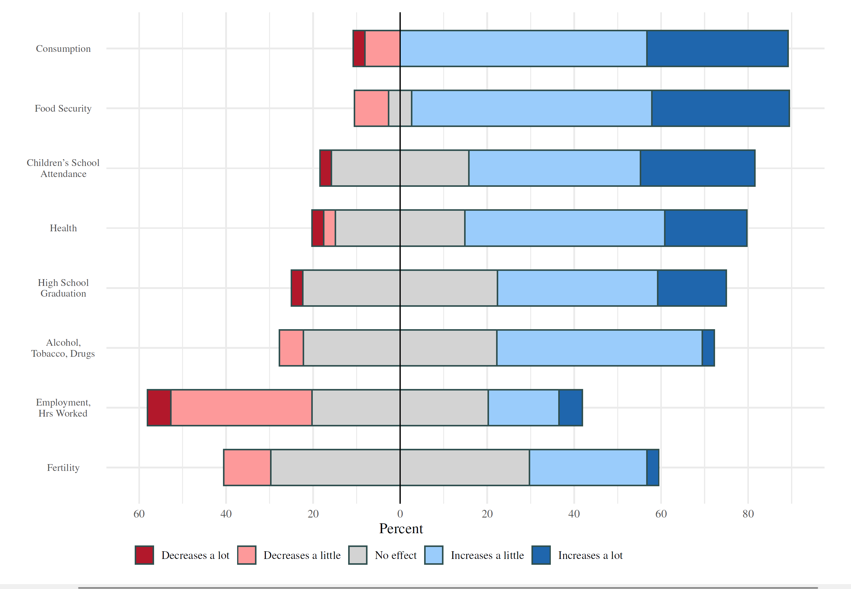
Notes:
We recently interview 56 high level policy makers for their views on social protection

Slide 16
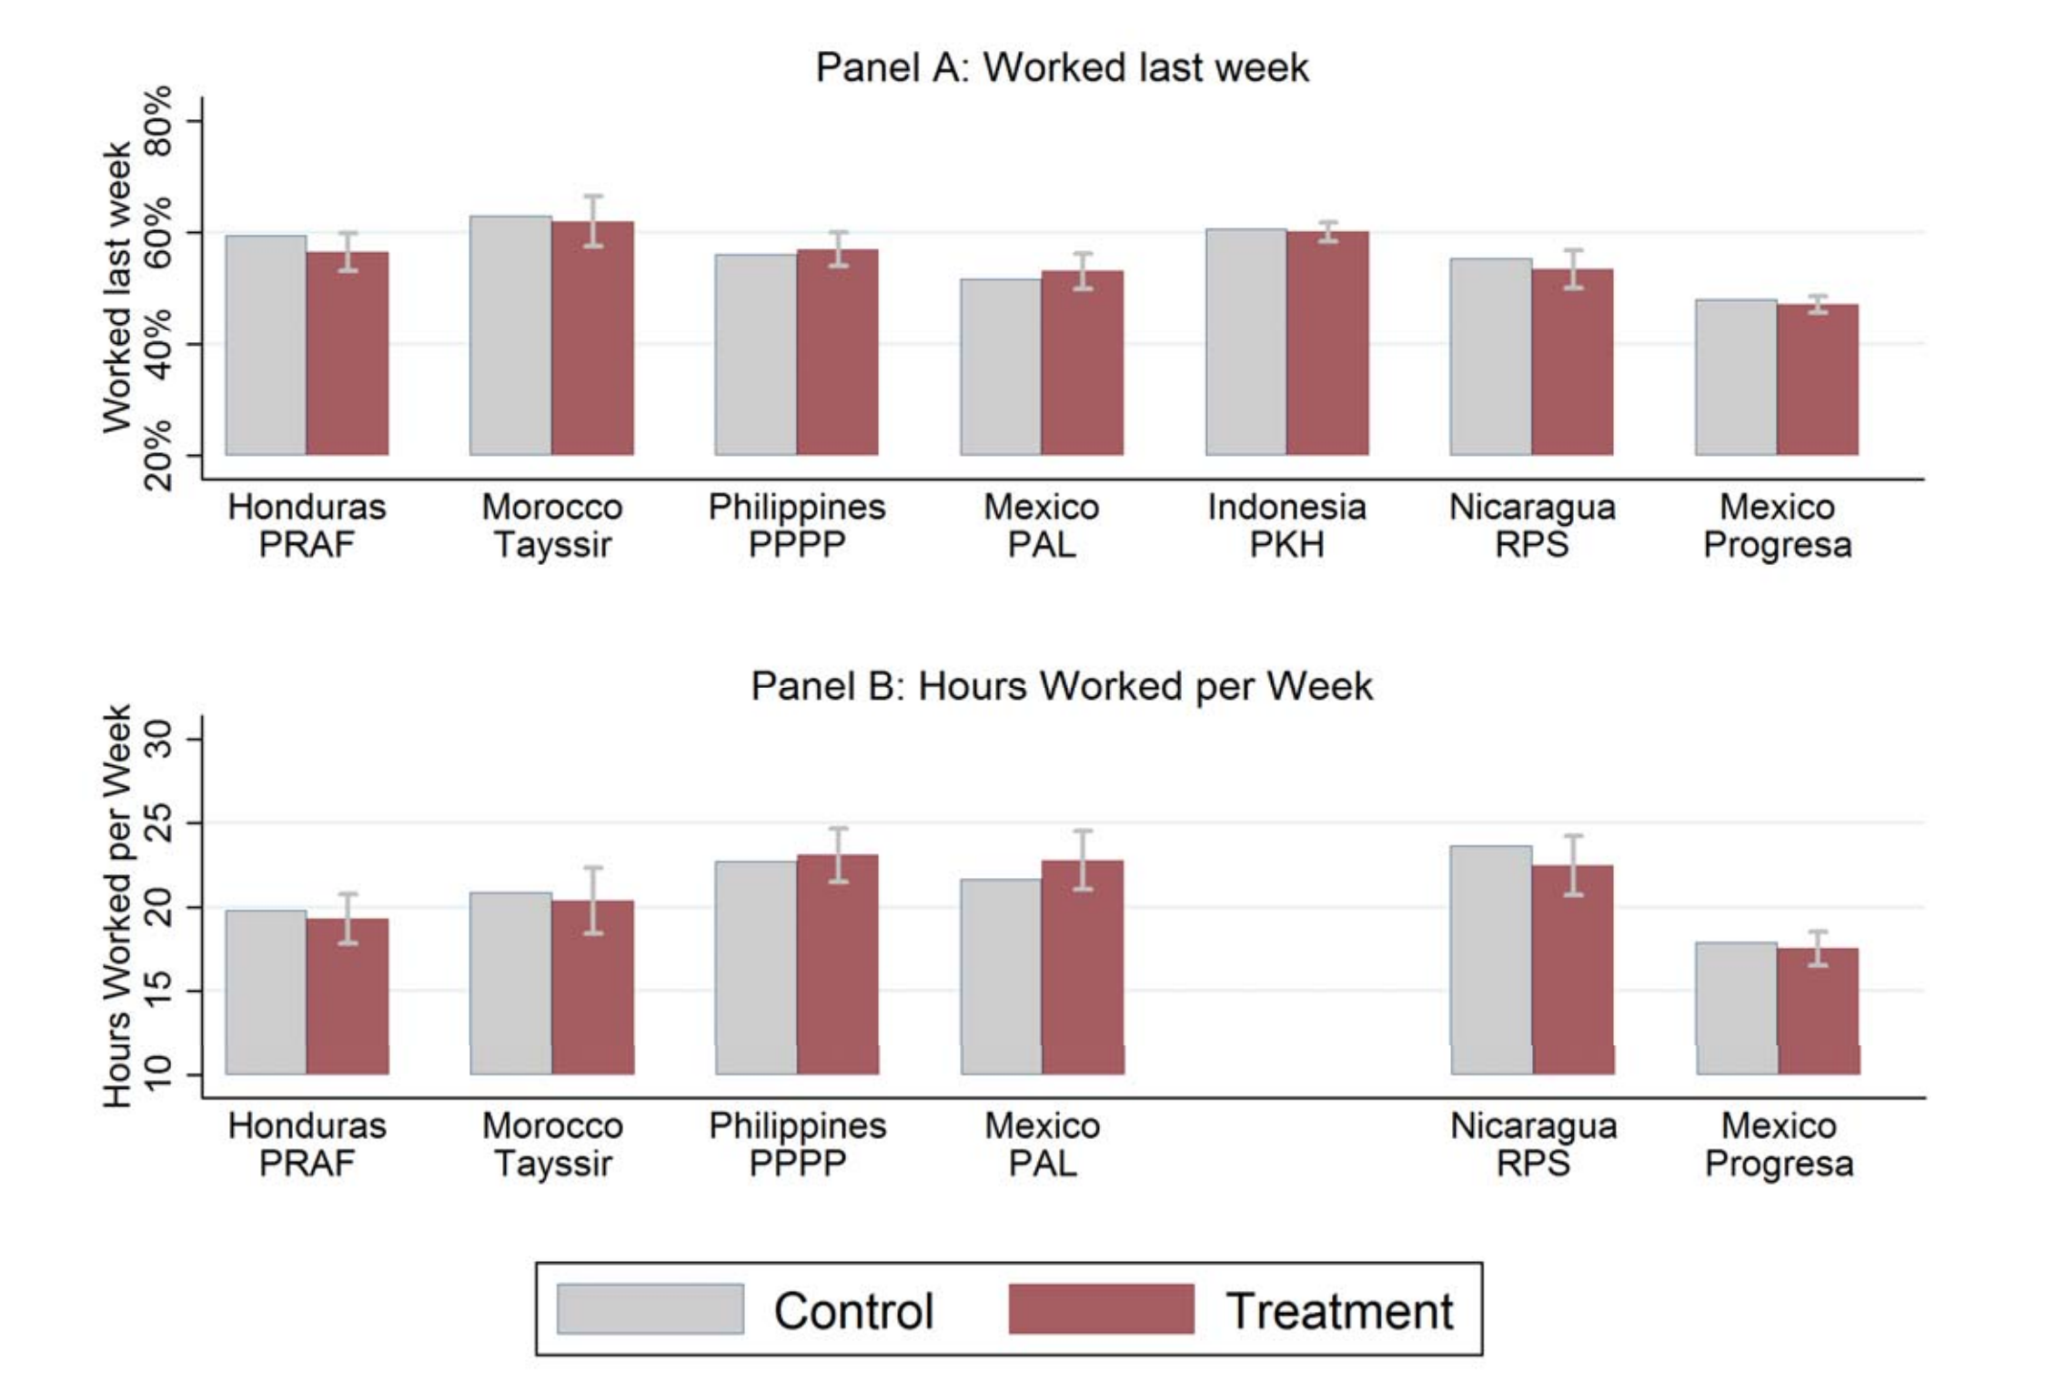
No evidence of dis-incentive effects for work
Banerjee, Hanna, Kreindler, Olken (2017)
Notes:
Many people who are on the programs work, and just do not earn enough for a variety of reasons. Others just need help because they face challenges (e.g., economic conditions, disabilities) that hinder work.

Slide 17
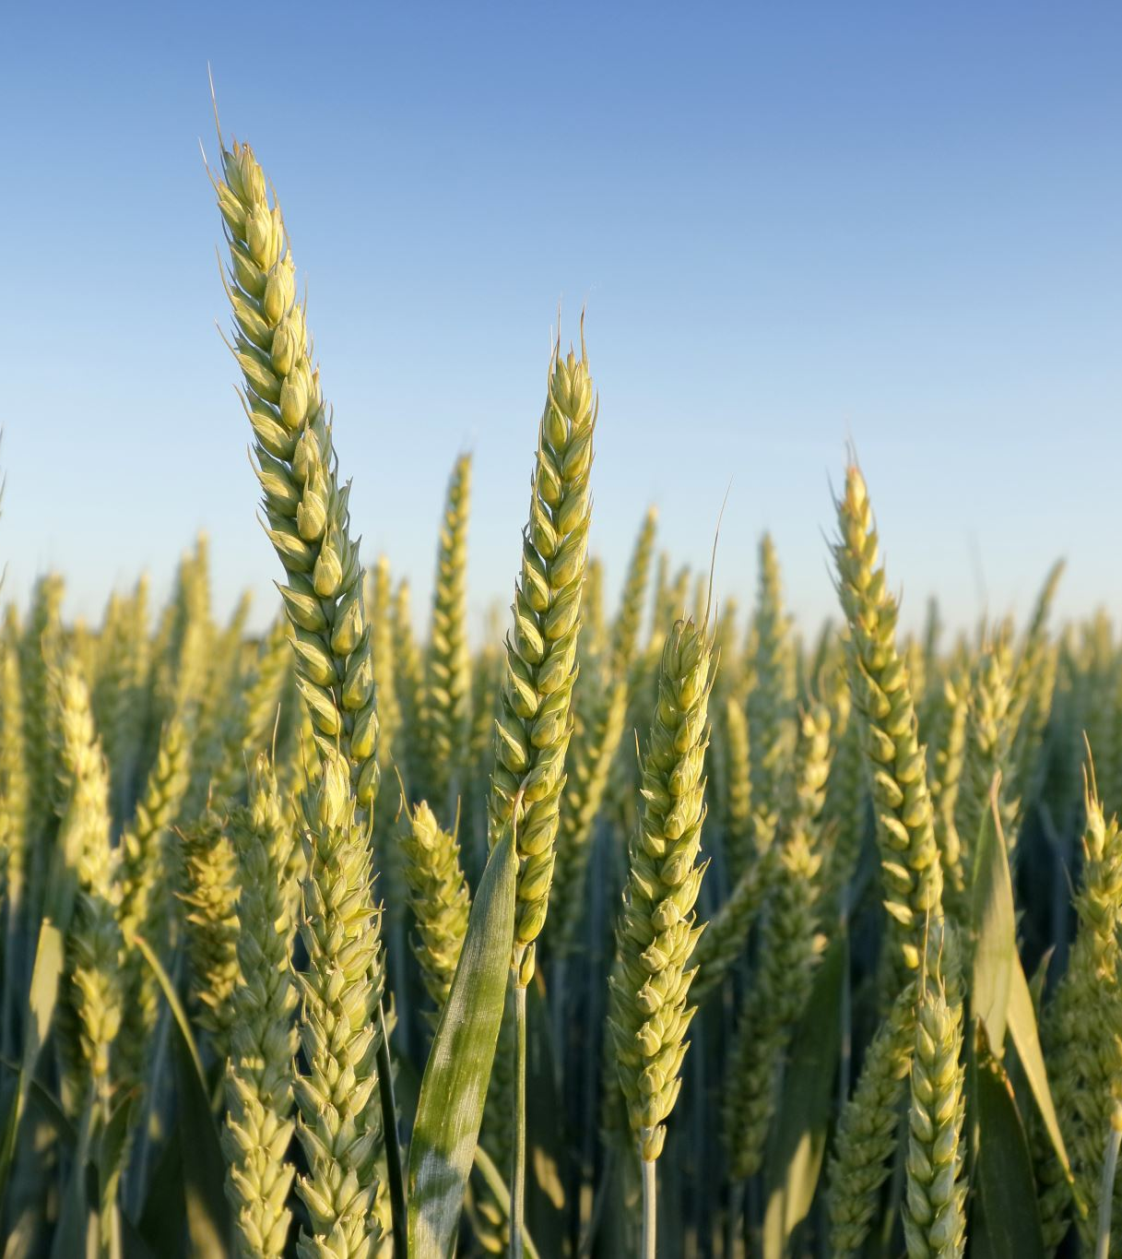
Emerging evidence that some of these programs can even boost productivity
Increasing health and educational investments for kids (e.g., Barham, Macours, and Maluccio 2018; Araujo and Macours 2021; Parker and Vogl 2023)
Increasing investments in business or farms (e.g., Gertler, Martinez, and Rubio-Codina 2012; Bandiera et al. 2017; Banerjee et al. 2015)

Slide 18
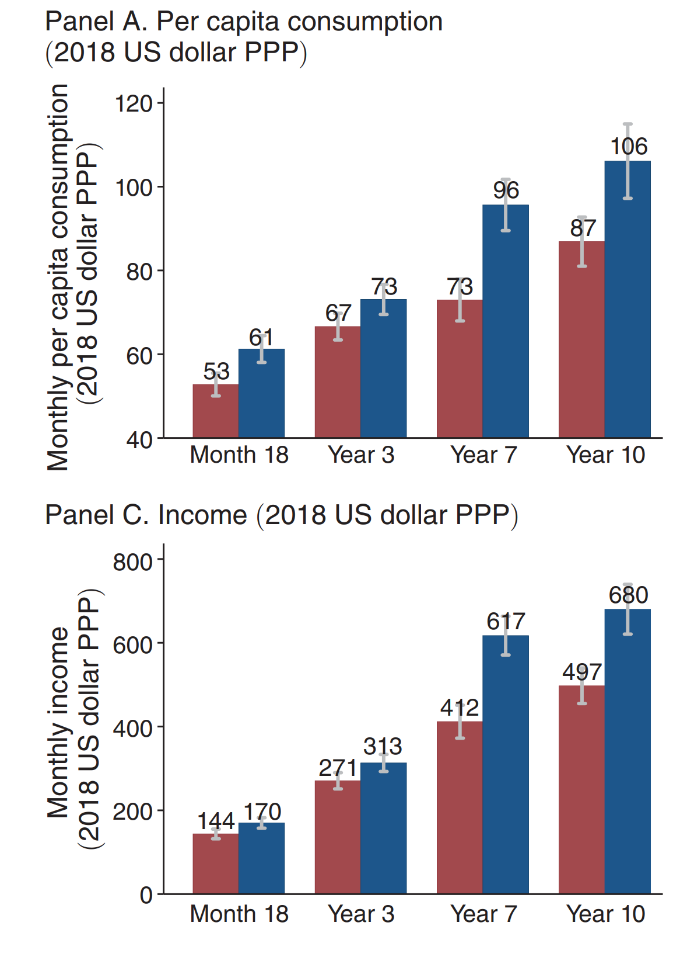
“Big-push” programs provide a large asset transfer to the poorest Indian households.
Treatment effects persist 10 years out
One channel for persistence is that treated households take better advantage of opportunities to diversify into more wage employment, especially through migration.
Banerjee, Duflo, and Sharma (2021)

Slide 19
Myth #2: These programs are no longer necessary
Social protection is seen as “anti-poverty” programs
As countries grow, and they transition out of poverty, these programs are obsolete

Slide 20
We plot social insurance expenditures as a share of GDP
Clear upward slope: richer countries, in general, spend much more on social insurance than poorer countries
The 2015 line is uniformly above the 1995 line: even at a given income level, countries tend to be doing more social protection than before
Notes: This is an updated and expanded version of Chetty and Looney (2006), which plots these data for 1996.

Slide 21
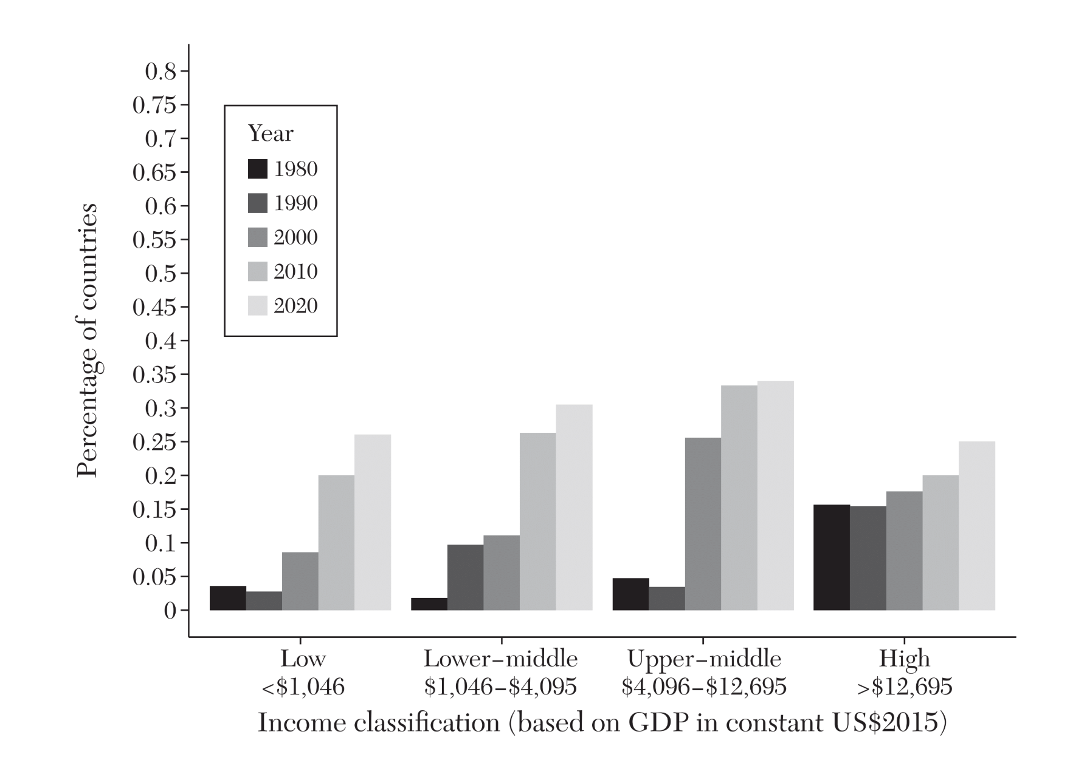
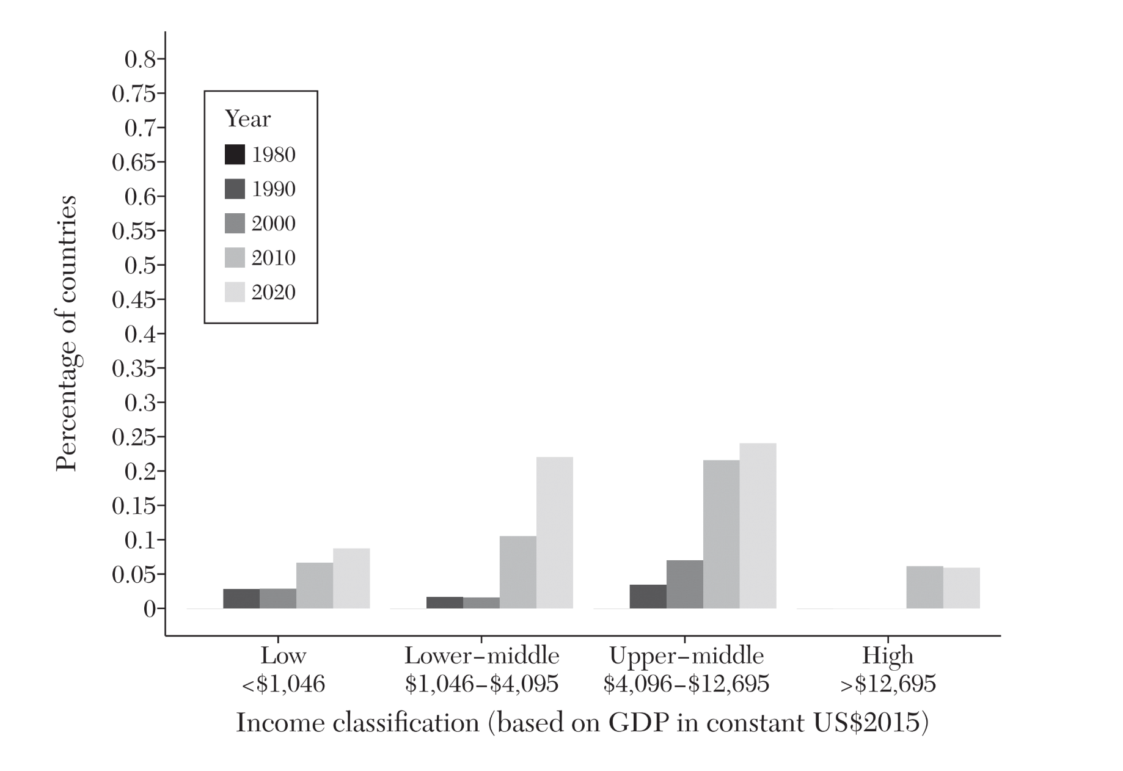
Increase social protections throughout income distribution and over time
Unconditional Cash Transfers
Conditional Cash Transfers

Slide 22
Important to note though….
The fact that these programs exist does not mean that they have sufficient budget to cover all of those who are in need
Some programs, such as Brazil’s Bolsa Familia conditional cash transfer, are enormous – Bolsa Familia in 2023 reached over 23 million families, or about 30 percent of the country (gov.br 2023).
Other programs are much smaller, such as Cote d’Ivoire’s Productive Social Safety Net project, which reaches less than half of 1 percent of the population (World Bank 2019).

Slide 23
Myth #3: These programs are expensive and are unaffordable
…more complex, depending on the politics, societies’ varying goals
…whether we consider both domestic resource mobilization and foreign aid

Slide 24
We conduct a simple exercise
What are the resources that each country would need to give everyone below the poverty line a transfer of PPP$2.15?
This is not perfect, but provides a benchmark to think about:
In principle, one could bring everyone to the poverty line for less money than this if one could give larger transfers to those further away from the poverty line, and smaller amounts to those closer to it–but this is harder logistically and so we assumed equal transfers.
On the other hand, this may understate the extent of the problem, since giving transfers only to those below the poverty line assumes that one can solve targeting challenges.

Slide 25
Most middle-income countries, including many lower-middle countries, are likely to be able to finance large, meaningful social assistance programs themselves.
Low-income countries cannot and will either need to have much more limited social assistance goals, or additional external assistance – or both.

Slide 26
Similar story when you examine the need as a function of government expenditure
Highlights financing challenge for lower-middle income

Slide 27
Could we solve global poverty?
We can calculate how much each country could contribute to combating poverty domestically if each country were to spend the same share of its national budget on social assistance as the United States
We then calculate how much additional financing is needed to provide a transfer of PPP$2.15 to every poor person in the world beyond that.

Slide 28
Money is not the issue….
It would take $100 billion per year total in global financing
To compare, in 2023, the OECD countries collectively gave $223 billion in official development assistance (OECD 2023) – more than 1.5 times what would be needed to cover cash transfers to eliminate poverty globally.
Notes:
Before recent events….

Slide 30
What are the challenges to doing so?
Budget
Not every country can solve on its on, need global coordination
Not the only program and policy we need to ensure people thrive, and countries face budgetary challenges and tradeoffs between programs
Policy Design and Logistics
This assumed perfect targeting – but this is hard in practice! How do we deliver the program funds? Is this even the right program, or is there a design that is better? In general, how do we think about how to design programs and policy?
Conflict
About 40 percent of the global poor live in conflict zones, and the World Bank predicts this is expected to rise
LMICs host 73 percent of the world's refugees (UNHCR)

Slide 31

We will try to explore these questions in the course
Each lecture will cover a different aspect of social protection, exploring what we know in the literature and open questions and debates
Each class mirrors a chapter in the “Handbook of Social Protection,” and advanced readings from it are provided online

Slide 32
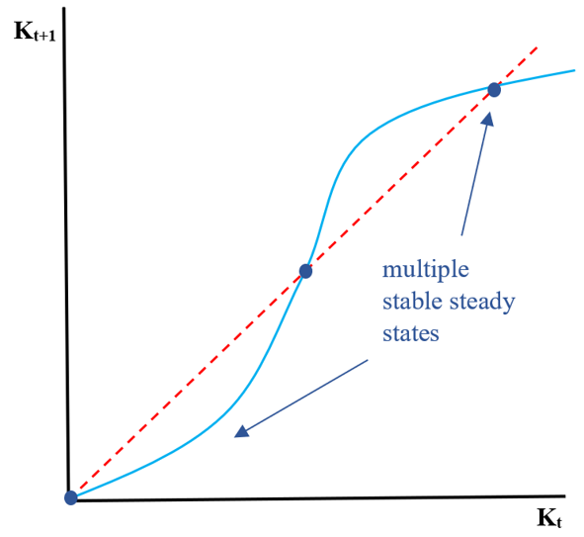
Lecture 2: Graduation Programs Lecturers: Oriana Bandiera, Munshi Sulaiman
Are people trapped in poverty?
Do big push programs have the potential to alleviate poverty traps?
What are they? How do they do so? How to best design and think about these programs?

Slide 33
Lecture 3: Cash transfers Lecturers: Paul Niehaus, Tavneet Suri
Lots of debates about cash transfer programs…
Notes:
Our next three lectures will cover cash transfers

Slide 34
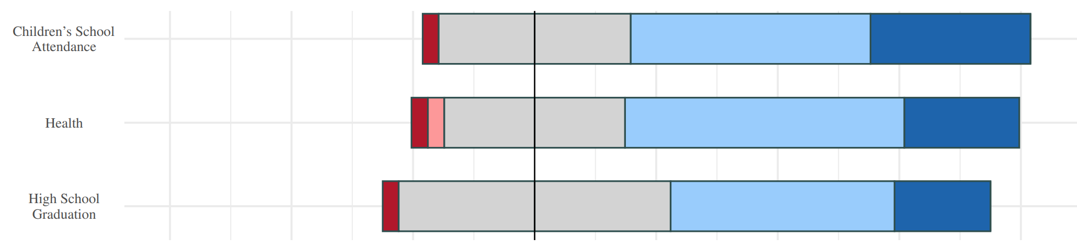
What do they do?

Slide 35
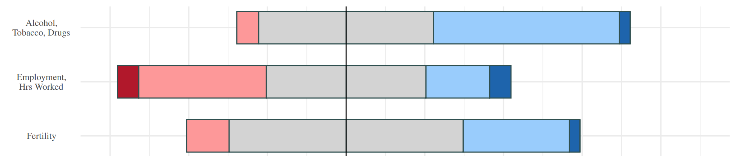
Do they encourage “bad” behaviors?

Slide 36
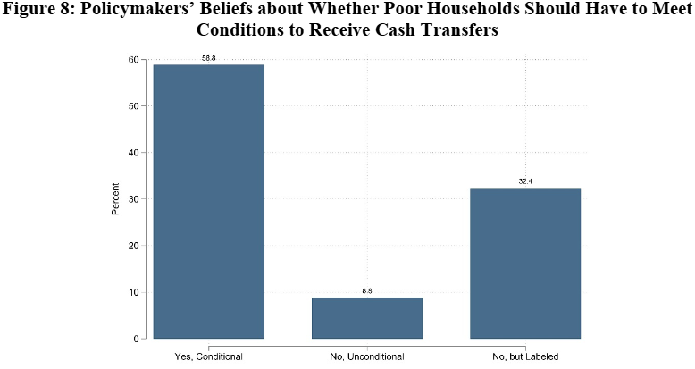
How should they be designed? How much should you give? How do you give? Should they be conditioned?

Slide 37
Lecture 3: Cash transfers Lecturers: Paul Niehaus, Tavneet Suri
Lots of debates about cash transfer programs…
This lecture will offer thoughts on some of the big picture policy debates around cash transfers

Slide 38
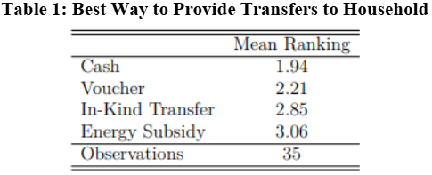
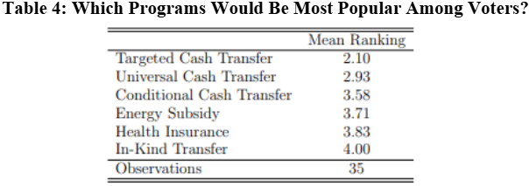
Lecture 4: The form of transfers: cash, in-kind, vouchers Lecturers: Lucie Gadenne, Monica Singhal
Debates over the best way to provide transfers

Slide 39
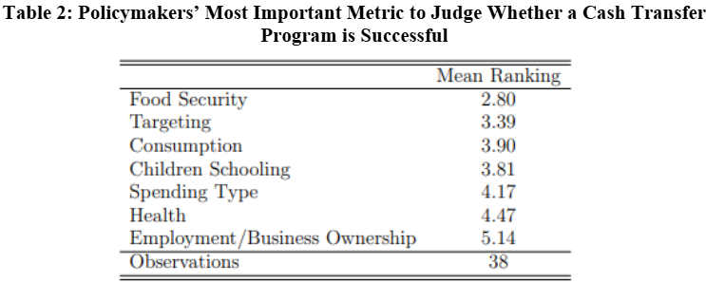
Lecture 5: Measuring the long-run impact of cash transfers Lecturers: Karen Macours, John Maluccio
Does it impact long-run health? Does it impact long-run employment opportunities? Would it decrease intergenerational poverty transmission?

Slide 40
Lecture 6: Identifying program beneficiaries Lecturers: Vivi Alatas, Abhijit Banerjee
Earlier in the lecture, we calculated how much funding it would take to provide everyone in poverty a transfer
But this is hard to do, and there is a lot of debate on the right methods.
Which methods work best? Data driven or soft information?
Do we want to target on poverty or other characteristics?
Should we even target?

Slide 41
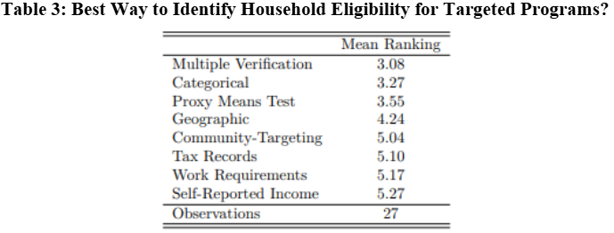
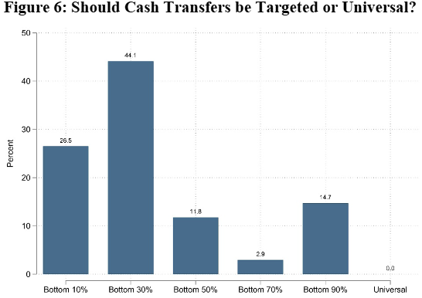

Slide 42
Lecture 7: Digital technology and social protection Lecturer: Sandip Sukhtankar
Technology is rapidly changing and will drastically change options available for social protection programs
From how we identify beneficiaries (e.g., electronic forms of enrollment) to how we distribute benefits (e.g., electronic debit cards, mobile money)
How do these new approaches compare to traditional approaches?

Slide 43
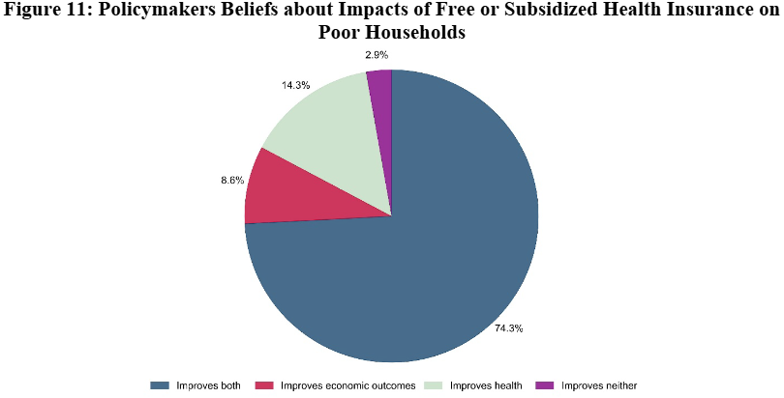
Lecture 8: Public health insurance Lecturers: Pascaline Dupas, Radhika Jain
What does health insurance do?

Slide 44
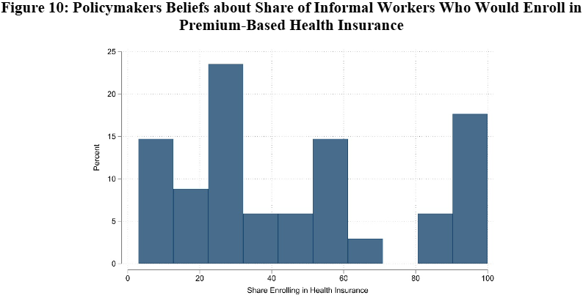
How do we deliver insurance when there is informality in the market?

Slide 45
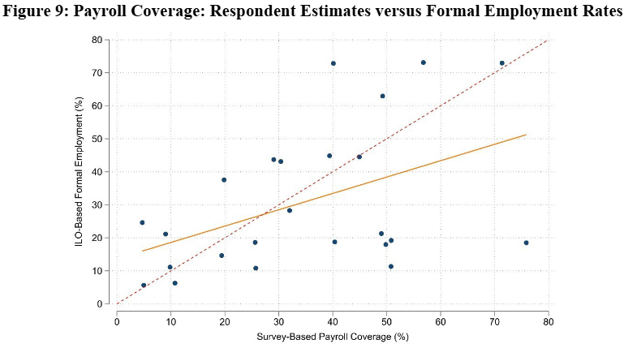
Lecture 9: Job displacement insurance Lecturers: Francois Gerard, Gustavo Gonzaga, Joana Naritomi
Similar to health insurance, unemployment insurance is difficult to deliver due to informality
Covers different ways of providing job displacement insurance given these issues

Slide 46
Lecture 10: Public works programs Lecturers: Arthur Alik-Lagrange, Clément Imbert
What are public works programs?
Are they an efficient means of redistribution?
Do they target the right people?
What are the effects on labor markets?
Notes:
Despite being widely used world wide, a lot less attention and research than cash transfers

Slide 47
Lecture 11: Spillovers and General Equilibrium Effects Lecturer: Ted Miguel
While we believe that spillovers and GE effects are important to understand in evaluating social protection programs, both logistical constraints (e.g., sample size) and methodological constraints prevent us from doing so
This lecture will dig into the current literature to examine what we know, but also propose directions for future research

Slide 48
Lecture 12: Social Protection, Conflict, and Reparations Lecturers: Arlen Guarin, Juliana Londoño-Vélez
As we discussed earlier, many of the poor live in conflict zones and a large share of the world’s refugees live in LMICs
What are impacts of social protection in conflict zones?
How do you deliver aid effectively under these challenging conditions?
Should you integrate refugees into existing programs, or have separate programs? Are there political costs of doing so?
Are reparations a victim-centric tool for transitioning from conflict to peace? What are the politics behind these social protection tools?

Slide 49
If you want to learn more….
Handbook of Social Protection will be coming out in 2026
Preview of some of the chapters through lectures and the associated readings
Covers even more topics including politics, gender, pensions, psychology, impacts on youth, energy subsidies, and more…

